Slide 1

Jinwoo Choi
Keimyung University
03/2017 – 08/2019
Digipen Institute of Technology
08/2021 – 04/2023
Undergraduate Teaching Assistant
09/2021 – 12/2021
Tiktok, AR Effect Software Engineer Intern
05/2022 – 08/2022
Tiktok, Software Engineer(XR Engine and Runtime) Fulltime
05/2023 –
Email
imjinwoo98@gmail.com

Slide 2
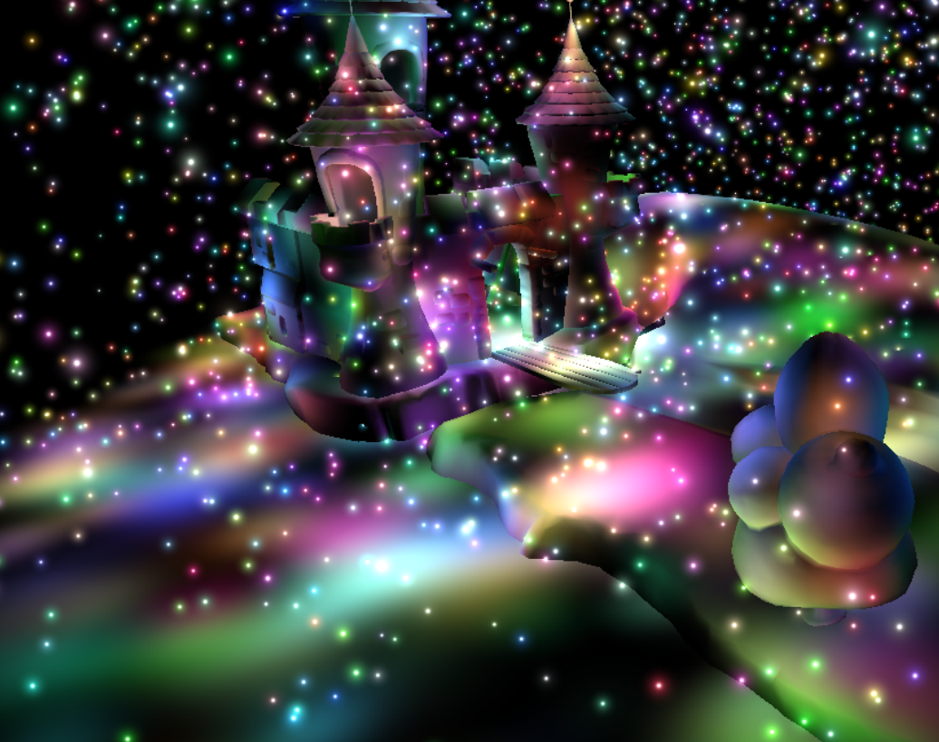
Deferred Shading
Jinwoo Choi

Slide 3
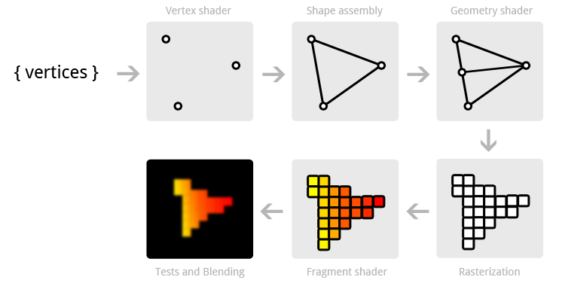
Rendering Pipeline
Vertices

Slide 4

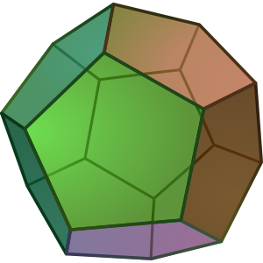

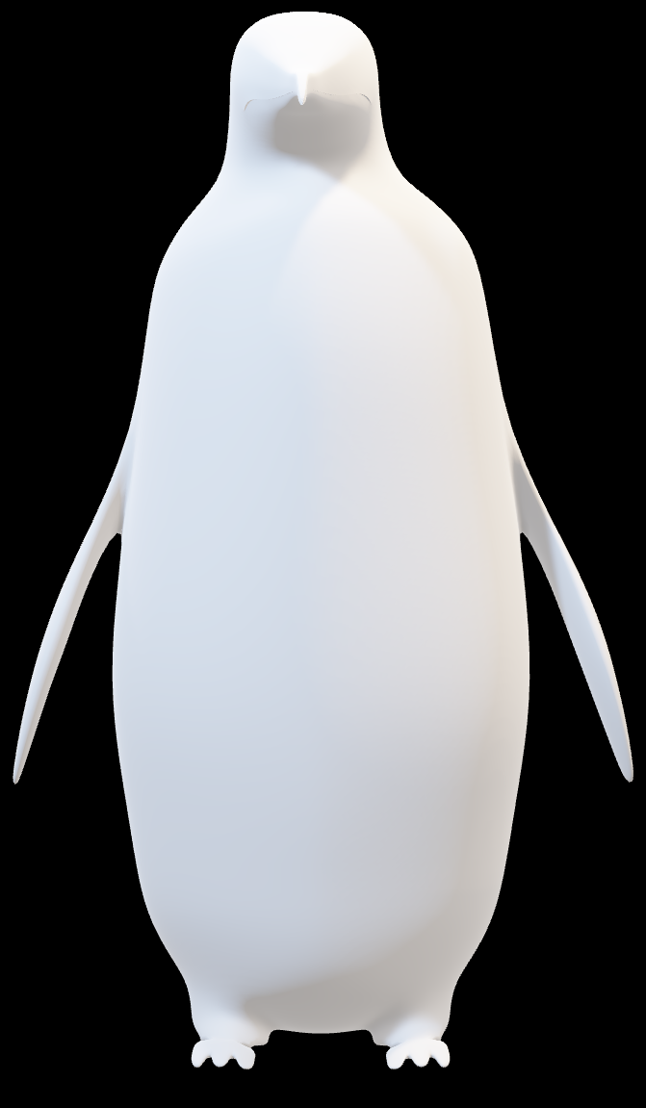

Lighting
glEnable (GL_CULL_FACE);
glCullFace (GL_BACK);

Slide 5

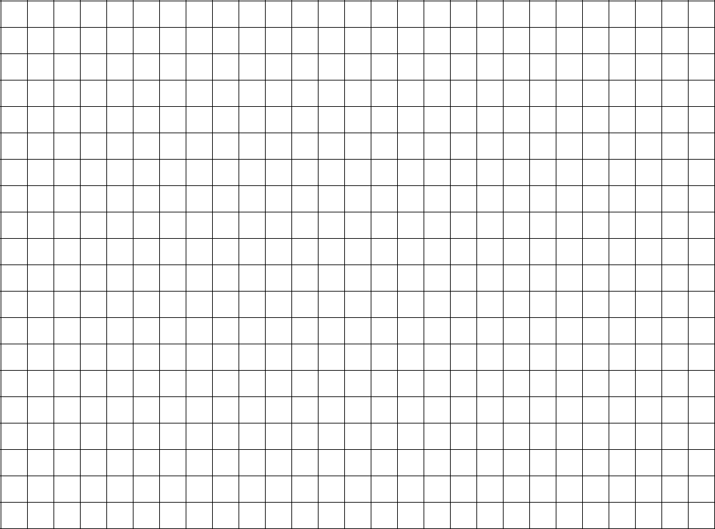

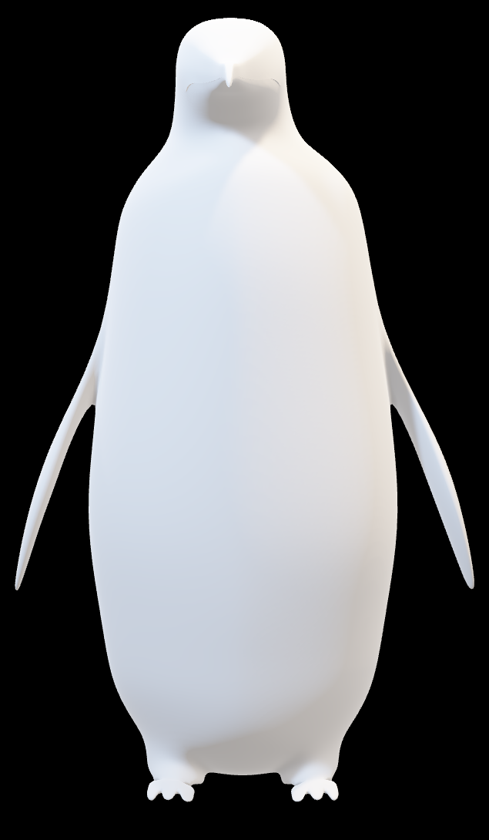

Forward Rendering

Slide 6
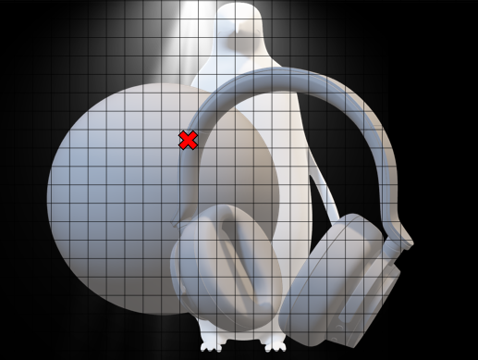



Forward Rendering

Slide 7


Deferred Shading
Texture2D

Slide 8
Deferred Shading

Slide 9

Deferred Shading

Slide 10
Deferred Shading

Slide 11
Deferred Shading

Slide 12
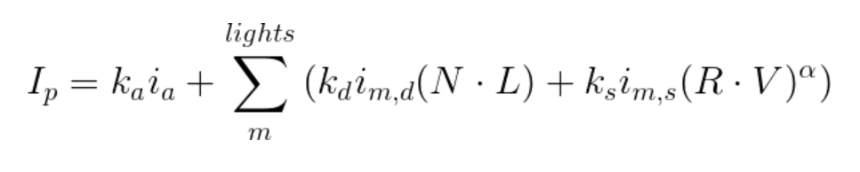
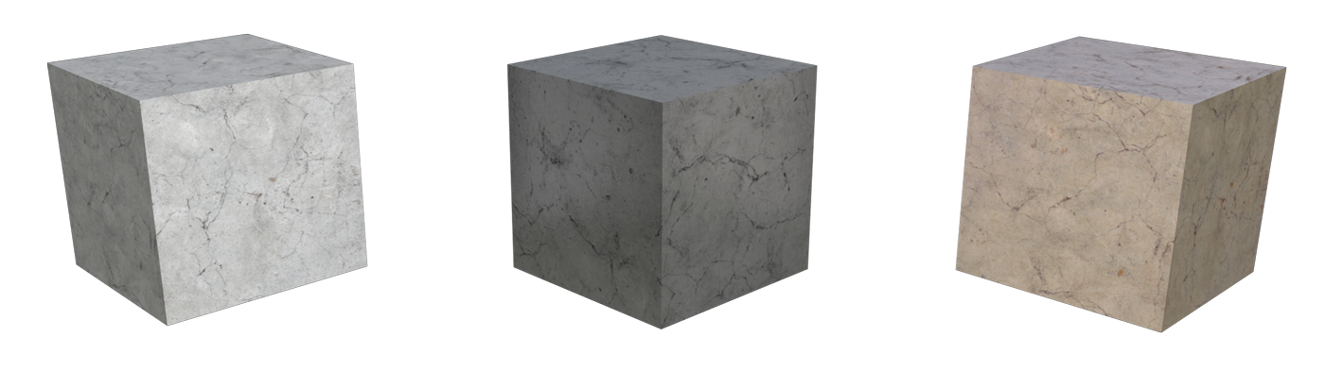
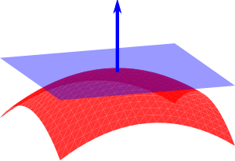
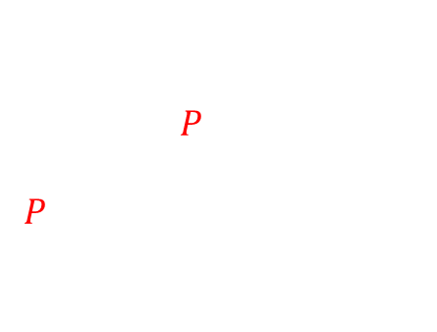
Deferred Shading
Material
Normal Vector
Light Vector
$L=P_{L}−P$
$P_{L}$: Position of Light
$P$: Position of Vertex

Slide 13

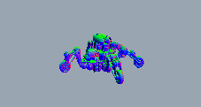










Texture
vec4
Texture
$$P_{x}$$
$$P_{y}$$
$$P_{z}$$
$$N_{x}$$
$$N_{y}$$
$$N_{z}$$
$$C_{x}$$
$$C_{y}$$
$$C_{z}$$
Position
Normal
Color

Slide 14
Texture
https://github.com/fendevel/Guide-to-Modern-OpenGL-Functions/blob/master/README.md
void glGenTextures (GLsizei n, GLuint* textures);
glGenTextures (1, &texture);
glBindTexture (GL_TEXTURE_2D, texture);
void glCreateTextures (GLenum target, GLsizei n, GLuint* textures);
glCreateTextures (GL_TEXTURE_2D, 1, &texture);

Slide 15
Texture
https://registry.khronos.org/OpenGL-Refpages/gl4/html/glTexParameter.xhtml
void glTexParameteri (GLenum target, GLenum pname, GLint param);
glTexParameteri (GL_TEXTURE_2D, GL_TEXTURE_WRAP_S, GL_CLAMP_TO_EDGE);
glTexParameteri (GL_TEXTURE_2D, GL_TEXTURE_WRAP_T, GL_CLAMP_TO_EDGE);
glTexParameteri (GL_TEXTURE_2D, GL_TEXTURE_MIN_FILTER, GL_NEAREST);
glTexParameteri (GL_TEXTURE_2D, GL_TEXTURE_MIN_FILTER, GL_NEAREST);
void glTextureParameteri (GLuint texture, GLenum pname, GLint param);
glTextureParameteri (texture, GL_TEXTURE_WRAP_S, GL_CLAMP_TO_EDGE);
glTextureParameteri (texture, GL_TEXTURE_WRAP_T, GL_CLAMP_TO_EDGE);
glTextureParameteri (texture, GL_TEXTURE_MIN_FILTER, GL_NEAREST);
glTextureParameteri (texture, GL_TEXTURE_MAG_FILTER, GL_NEAREST);

Slide 16
Texture
https://registry.khronos.org/OpenGL-Refpages/gl4/html/glTexImage2D.xhtml
void glTexImage2D (GLenum target, … GLsizei height, GLsizei width, … GLenum type, const void* data);
glTexImage2D (GL_TEXTURE_2D, 0, GL_RGBA16F, width, height, 0, GL_RGBA, GL_FLOAT, nullptr);
void glTextureStorage2D (GLuint texture, GLsizei levels, … GLsizei width, GLsizei height);
glTextureStorage2D (texture, 0, GL_ RGBA16F , width, height);
glTextureSubImage2D (texture, 0, 0, 0, width, height, GL_ RGBA, GL_FLOAT, nullptr);

Slide 17
Texture
void glActiveTexture (GLenum texture);
glActiveTexture (GL_TEXTURE0 + 3);
glBindTexture (GL_TEXTURE_2D, texture);
void glBindTextureUnit (GLuint unit, GLuint texture);
glBindTextureUnit (3, texture);

Slide 18
Texture
OpenGL 2.0+
glGenTextures (1, &texture);
glBindTexture (GL_TEXTURE_2D, texture);
glTexParameteri (GL_TEXTURE_2D, GL_TEXTURE_WRAP_S, GL_CLAMP_TO_EDGE);
glTexParameteri (GL_TEXTURE_2D, GL_TEXTURE_WRAP_T, GL_CLAMP_TO_EDGE);
glTexParameteri (GL_TEXTURE_2D, GL_TEXTURE_MIN_FILTER, GL_NEAREST);
glTexParameteri (GL_TEXTURE_2D, GL_TEXTURE_MIN_FILTER, GL_NEAREST);
glTexImage2D (GL_TEXTURE_2D, 0, GL_RGBA16F, width, height, 0, GL_RGBA, GL_FLOAT, nullptr);
glActiveTexture (GL_TEXTURE0 + n);
glBindTexture (GL_TEXTURE_2D, texture);
n = 0, 1, 2 …
OpenGL 4.5+
glCreateTextures (GL_TEXTURE_2D, 1, &texture);
glTextureParameteri (texture, GL_TEXTURE_WRAP_S, GL_CLAMP_TO_EDGE);
glTextureParameteri (texture, GL_TEXTURE_WRAP_T, GL_CLAMP_TO_EDGE);
glTextureParameteri (texture, GL_TEXTURE_MIN_FILTER, GL_NEAREST);
glTextureParameteri (texture, GL_TEXTURE_MAG_FILTER, GL_NEAREST);
glTextureStorage2D (texture, 0, GL_ RGBA16F , width, height);
glTextureSubImage2D (texture, 0, 0, 0, width, height, GL_ RGBA, GL_FLOAT, nullptr);
glBindTextureUnit (n, texture);
n = 0, 1, 2 …

Slide 19
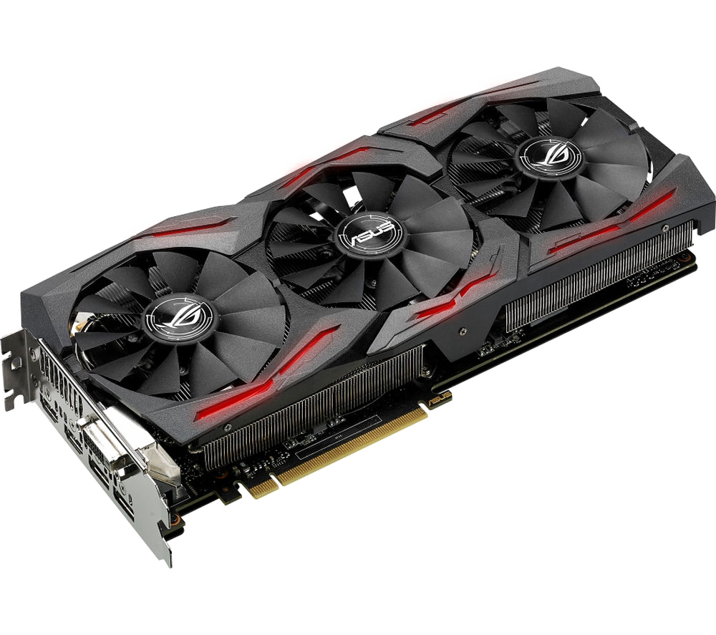

Frame Buffer(VRAM)
Memory that stores the color values for each pixel on the display

Slide 20



Frame Buffer
render
Draw call
Generate
Framebuffer
+
Attach texture,
render buffer
render
Bind
Framebuffer
Unbind
Framebuffer
…
Draw call

Slide 21
Frame Buffer
OpenGL 4.5+
class FBO // Frame Buffer Object
{
public:
FBO();
~FBO();
void Initialize(unsigned width, unsigned height);
void Bind();
void Unbind();
private:
unsigned GBuffer0, GBuffer1, GBuffer2; //texture, render target
unsigned u_GBuffer0, u_GBuffer1, u_GBuffer2; // texture unit
unsigned fbo_handle; //Frame Buffer Object Handle
unsigned rbo_handle; //Render Buffer Object Handle
}

Slide 22
FBO-Create FBO
void glGenFramebuffers (GLsizei n, GLuint* ids);
glGenFramebuffers (1, &fbo_handle);
glBindFramebuffer (GL_FRAMEBUFFER, fbo_handle);
void glCreateFramebuffers (GLsizei n, GLuint* framebuffers);
glCreateFrameBuffers (1, &fbo_handle);

Slide 23
FBO-RBO
void glGenRenderbuffers (GLsizei n, GLuint* ids);
glGenRenderbuffers (1, &rbo_handle);
glBindRenderbuffer (GL_RENDERBUFFER, rbo_handle); // replace rbo_handle with 0 means unbind
void glCreateRenderbuffers (GLsizei n, GLuint* renderbuffers);
glCreateRenderbuffers (1, &rbo_handle);

Slide 24
FBO-Attach RBO
void glRenderbufferStorage (GLenum target, GLenum internalformat, GLsizei width, GLsizei height);
void glNamedRenderbufferStorage (GLenum renderbuffer, GLenum internalformat, GLsizei width, GLsizei height);
glRenderbufferStorage (GL_RENDERBUFFER, GL_DEPTH_COMPONENT, width, height);
glNamedRenderbufferStorage (rbo_handle, GL_DEPTH_COMPONENT, width, height);
void glFramebufferRenderbuffer (GLenum target, GLenum internalformat, GLenum renderbuffertarget, GLuint renderbuffer);
void glNamedFramebufferRenderbuffer (GLuint framebuffer, GLenum internalformat, GLenum renderbuffertarget, GLuint renderbuffer);
glFramebufferRenderbuffer (GL_FRAMEBUFFER, GL_DEPTH_ATTACHMENT, GL_RENDERBUFFER, rbo_handle);
glNamedFramebufferRenderbuffer (fbo_handle, GL_DEPTH_ ATTACHMENT, GL_RENDERBUFFER , rbo_handle);

Slide 25
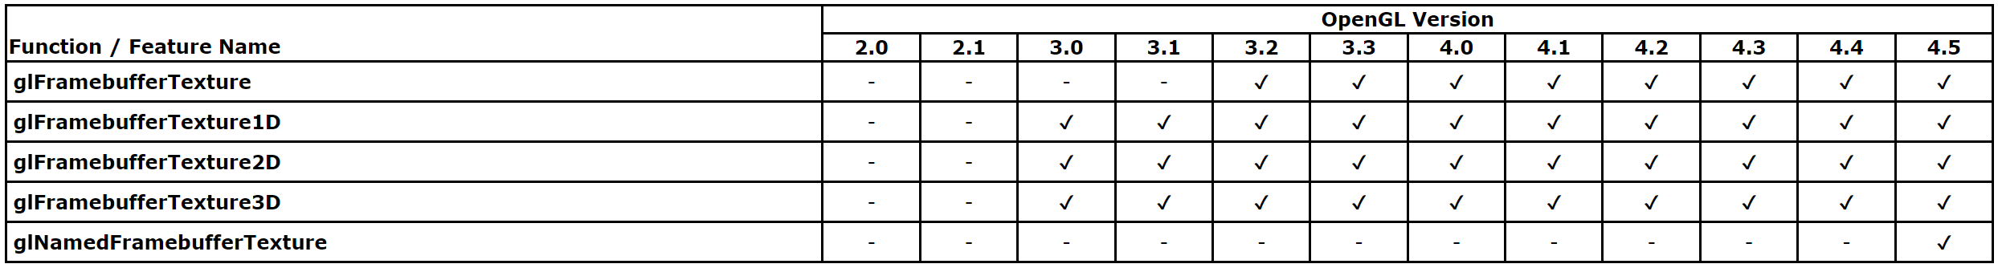
FBO-Attach Texture
void glFramebufferTexture2D (GLenum target, GLenum attachment, GLenum textarget, GLuint texture, GLint level);
void glNamedFramebufferTexture (GLuint framebuffer, GLenum attachment, GLuint texture, GLint level);
glFramebufferTexture2D (GL_FRAMEBUFFER , GL_COLOR_ATTACHMENT0, GL_TEXTURE_2D, GBuffer1, 0);
glNamedFramebufferTexture (fbo_handle, GL_COLOR_ATTACHMENT0, GBuffer1, 0);

Slide 26
FBO-Specify a list
void glDrawBuffers (GLsizei n, const GLenum* bufs);
void glNamedFramebufferDrawBuffers (GLuint framebuffer, GLsizei n, const GLenum* bufs);
glDrawBuffers (3, buffers);
glNamedFramebufferDrawBuffers (fbo_handle, 3, buffers);
GLenum buffers[3] = {GL_COLOR_ATTACHMENT0, GL_COLOR_ATTACHMENT1, GL_COLOR_ATTACHMENT2};

Slide 27
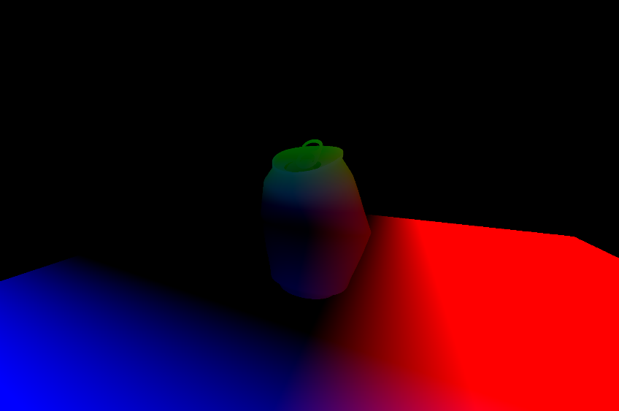
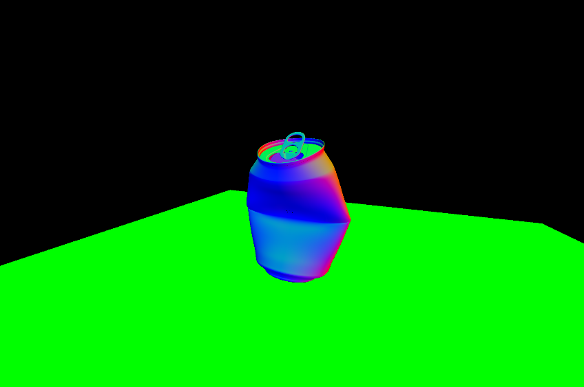
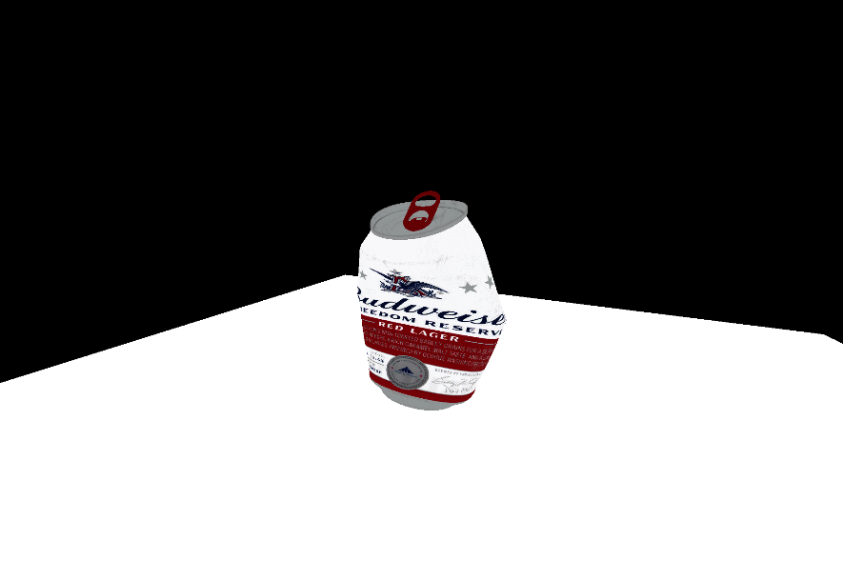
FBO-Specify a list
GLenum buffers[3] = {GL_COLOR_ATTACHMENT0, GL_COLOR_ATTACHMENT1, GL_COLOR_ATTACHMENT2};
Fragment Shader
layout (location=0) in vec4 position;
layout (location=1) in vec4 normal;
layout (location=2) in vec4 color;
layout (location=0) out vec4 GBuffer0;
layout (location=1) out vec4 GBuffer1;
layout (location=2) out vec4 GBuffer2;
…
void main( )
{
GBuffer0 = position ;
GBuffer1 = normal;
GBuffer2 = color;
}

Slide 28
FBO-Validate
GLenum glCheckFramebufferStatus (GLenum target);
GLenum glCheckNamedFramebufferStatus (GLuint framebuffer, GLenum target);
glCheckFramebufferStatus (GL_FRAMEBUFFER);
glCheckNamedFramebufferStatus (fbo_handle, GL_FRAMEBUFFER);
if ( glCheckNamedFramebufferStatus (fbo_handle, GL_FRAMEBUFFER) != GL_FRAMEBUFFER_COMPLETE)
{
// Check error with return value
}

Slide 29
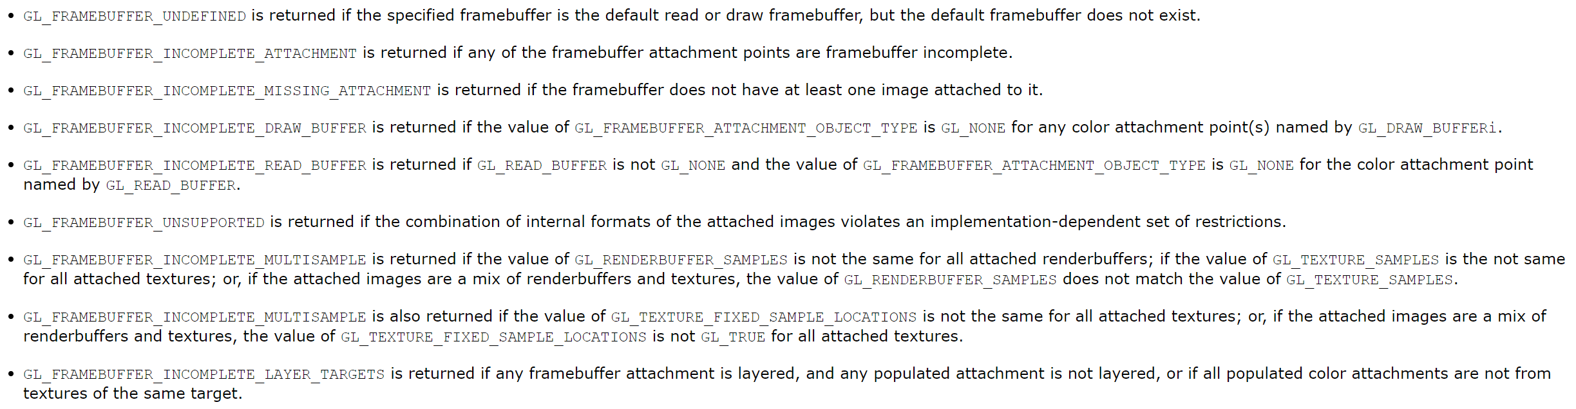
FBO-Validate

Slide 30
Geometry Pass
Generate
Framebuffer
+
Attach texture,
render buffer
render
Bind
Framebuffer
Unbind
Framebuffer
…
Draw call

Slide 31
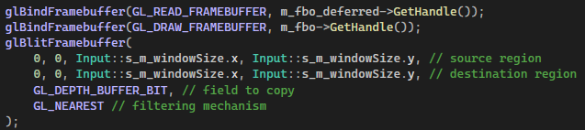
Geometry Pass-Bind
void glBindFramebuffer (GLenum target, GLuint framebuffer);
glBindFramebuffer (GL_FRAMEBUFFER, fbo_handle);
glBindFramebuffer (GL_FRAMEBUFFER, 0); // default framebuffer

Slide 32
Geometry Pass-Overview
OpenGL 3.0+
glGenFramebuffers (1, &fbo_handle);
glBindFramebuffer (GL_FRAMEBUFFER, fbo_handle);
glGenRenderbuffers (1, &rbo_handle);
glBindRenderbuffer (GL_RENDERBUFFER, rbo_handle);
glRenderbufferStorage (GL_RENDERBUFFER, GL_DEPTH_COMPONENT, width, height);
glFramebufferRenderbuffer (GL_FRAMEBUFFER, GL_DEPTH_ATTACHMENT, GL_RENDERBUFFER, rbo_handle);
glFramebufferTexture2D (GL_FRAMEBUFFER , GL_COLOR_ATTACHMENT0, GL_TEXTURE_2D, GBuffer0, 0);
glFramebufferTexture2D (GL_FRAMEBUFFER , GL_COLOR_ATTACHMENT1, GL_TEXTURE_2D, GBuffer1, 0);
glFramebufferTexture2D (GL_FRAMEBUFFER , GL_COLOR_ATTACHMENT2, GL_TEXTURE_2D, GBuffer2, 0);
glDrawBuffers (3, buffers);
if (glCheckFramebufferStatus (GL_FRAMEBUFFER) != GL_FRAMEBUFFER_COMPLETE)
{
// Check error with return value
}
glBindRenderbuffer (GL_RENDERBUFFER, 0); //unbind
glBindFramebuffer (GL_FRAMEBUFFER, 0); //use default framebuffer
glBindFramebuffer (GL_FRAMEBUFFER, fbo_handle);
// Draw call here
glBindFramebuffer (GL_FRAMEBUFFER, 0);

Slide 33
Geometry Pass-Overview
OpenGL 4.5+
glCreateFrameBuffers (1, &fbo_handle);
glCreateRenderbuffers (1, &rbo_handle);
glNamedRenderbufferStorage (rbo_handle, GL_DEPTH_COMPONENT, width, height);
glNamedFramebufferRenderbuffer (fbo_handle, GL_DEPTH_ ATTACHMENT, GL_RENDERBUFFER , rbo_handle);
glNamedFramebufferTexture (fbo_handle, GL_COLOR_ATTACHMENT0, GBuffer0, 0);
glNamedFramebufferTexture (fbo_handle, GL_COLOR_ATTACHMENT1, GBuffer1, 0);
glNamedFramebufferTexture (fbo_handle, GL_COLOR_ATTACHMENT2, GBuffer2, 0);
glNamedFramebufferDrawBuffers (fbo_handle, 3, buffers);
if ( glCheckNamedFramebufferStatus (fbo_handle, GL_FRAMEBUFFER) != GL_FRAMEBUFFER_COMPLETE)
{
// Check error with return value
}
glBindRenderbuffer (GL_RENDERBUFFER, 0); //unbind
glBindFramebuffer (GL_FRAMEBUFFER, 0); //back to default framebuffer
glBindFramebuffer (GL_FRAMEBUFFER, fbo_handle);
// Draw call here
glBindFramebuffer (GL_FRAMEBUFFER, 0);

Slide 34
Geometry Pass
OpenGL 4.5+
glBindFramebuffer (GL_FRAMEBUFFER, fbo_handle);
// Draw call here
glBindFramebuffer (GL_FRAMEBUFFER, 0);
glUseProgram (shader_handle);
…
glDrawArrays (…); //or glDrawElements
glUseProgram (0);

Slide 35
Geometry Pass
glUseProgram (shader_handle);
…
glDrawArrays (…); //or glDrawElements
glUseProgram (0);
Vertex Shader
Fragment Shader
layout (location=0) in vec4 position_in;
layout (location=1) in vec4 normal_in;
layout (location=2) in vec2 texcoord_in;
layout (location=0) out vec4 position;
layout (location=1) out vec4 normal;
layout (location=2) out vec4 color;
uniform sampler2D color_texture;
void main( )
{
position = … ; //world coordinate
normal= normalize(…); //world coordinate
color= texture2D(color_texture, texcoord_in) ;
gl_Position = worldToNDC * position;
}
layout (location=0) in vec4 position;
layout (location=1) in vec4 normal;
layout (location=2) in vec4 color;
layout (location=0) out vec4 GBuffer0;
layout (location=1) out vec4 GBuffer1;
layout (location=2) out vec4 GBuffer2;
…
void main( )
{
GBuffer0 = position ;
GBuffer1 = normal;
GBuffer2 = color;
}

Slide 36
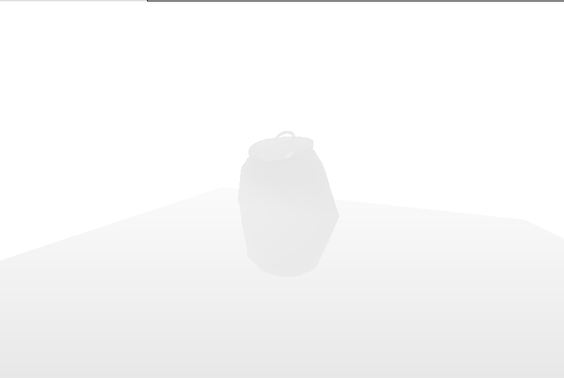
Lighting Pass
Framebuffer

Slide 37
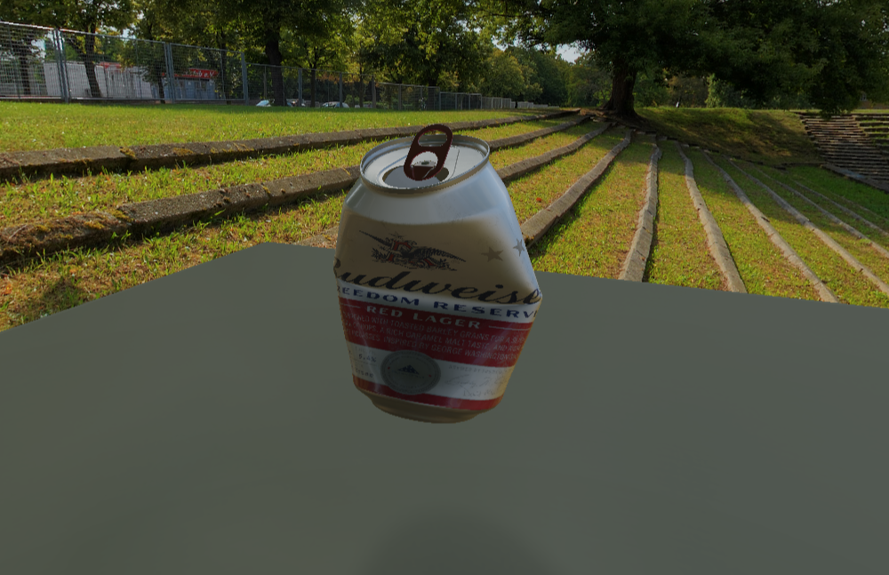
Lighting Pass
Framebuffer

Slide 38

Review
Generate
Framebuffer
Generate
Gbuffers(textures)
and Renderbuffer
Attach
Gbuffers and renderbuffer
to the framebuffer
Bind
Framebuffer
Unbind
Framebuffer
Bind Gbuffers
to the lighting shader
Draw Full screen Quad
with using Gbuffer data corresponding to each pixel
Draw call

Slide 39
Advanced
GBuffer0
Pos.x
Pos.y
Pos.z
null
GBuffer1
Norm.x
Norm.y
Norm.z
null
GBuffer2
R
G
B
null
GBuffer3
null
null
null
null

Slide 40
Pros & Cons
Lighting is less dependent on geometry
Worst case complexity depends on number of object and lights
Easy to integrate with screen-space techniques such as shadow mapping, temporal anti-aliasing
Hard to support a wide variety of materials
Cannot handle translucent or transparent objects

Slide 41
Forward + Deferred
.
.
.
Blit
Framebuffer
Default Framebuffer(Screen)
Forward Rendering
Renderbuffer(Depth)

Slide 42
Forward + Deferred
void glBlitFramebuffer (GLint srcX0, GLint srcY0, GLint srcX1, GLint srcY1, GLint dstX0, GLint dstY0, GLint dstX1, GLint dstY1, GLbitfield mask, GLenum filter);
glBindFramebuffer (GL_READ_FRAMEBUFFER, fbo_handle);
glBindFramebuffer (GL_DRAW_FRAMEBUFFER, 0);
glBlitFramebuffer (
0, 0, width, height,
0, 0, width, height,
GL_DEPTH_BUFFER_BIT,
GL_NEAREST
);

Slide 43
Forward + Deferred
void glBlitNamedFramebuffer (GLuint readFramebuffer, GLuint drawFramebuffer, GLint srcX0, GLint srcY0, GLint srcX1, GLint srcY1, GLint dstX0, GLint dstY0, GLint dstX1, GLint dstY1, GLbitfield mask, GLenum filter);
glBlitFramebuffer (
fbo_handle, 0,
0, 0, width, height,
0, 0, width, height,
GL_DEPTH_BUFFER_BIT,
GL_NEAREST
);

Slide 44
Forward + Deferred
Bind
Framebuffer
Unbind
Framebuffer
Bind Gbuffers
to the lighting shader
Draw call
Draw Full screen Quad
with using Gbuffer data corresponding to each pixel
Blit
from user defined FBO
to default one
Forward Rendering

Slide 45
Local Lighting
Deferred Rendering

Slide 46
Local Lighting
gl_FragCoord.xy/u_window_size.xy
Additive Blending On
Depth Test Off
Face Culling On

Slide 47



Internship
Resume
Portfolio
Personal Projects
(Digipen Handshake resume guideline)
https://digipen.joinhandshake.com/stu/schools/1396/articles
LinkedIn, Leetcode, etc.

